Slide 1


Mid bootcamp project
A model to estimate house price in King County
Hangover Team
Marc Puyol
Sergi Guasch
February 2022

Slide 2
Our approach to a best performing model
Year renovated = Year built
Most recent date in the duplicates id (no null values)
Trying to do the best time/cost analysis we deleted the duplicates since they were a very little subsample
Checking the outliers in the histograms and scatter plots (scatter matrix) we drop irrelevant and inconsistent values, and try to normalize the numerical variables (3 stdv)

Slide 3
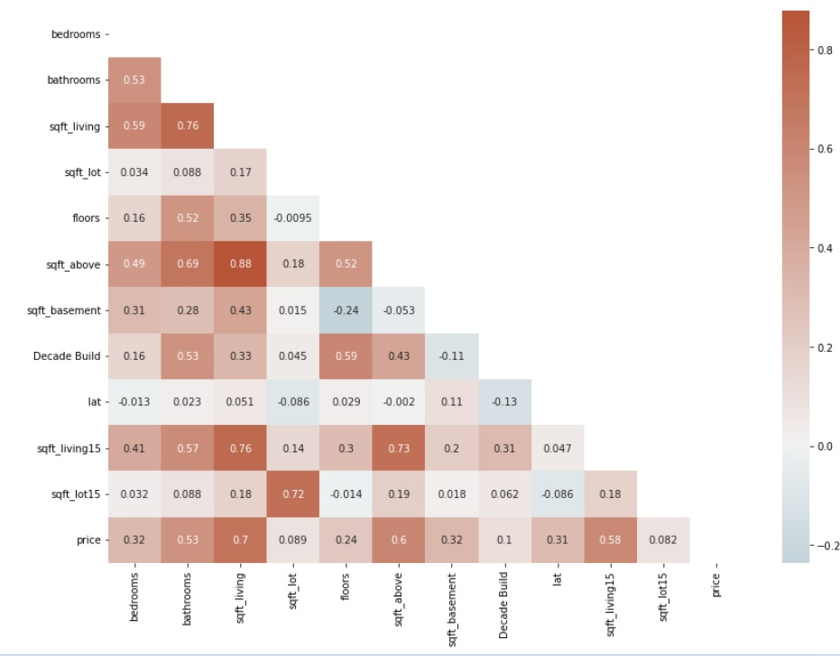
Correlation analysis:
Most relevant variables (Sqft Living)
Avoid multicollinearity between Sqft_Living and Sqft Above (0.88)

Slide 4
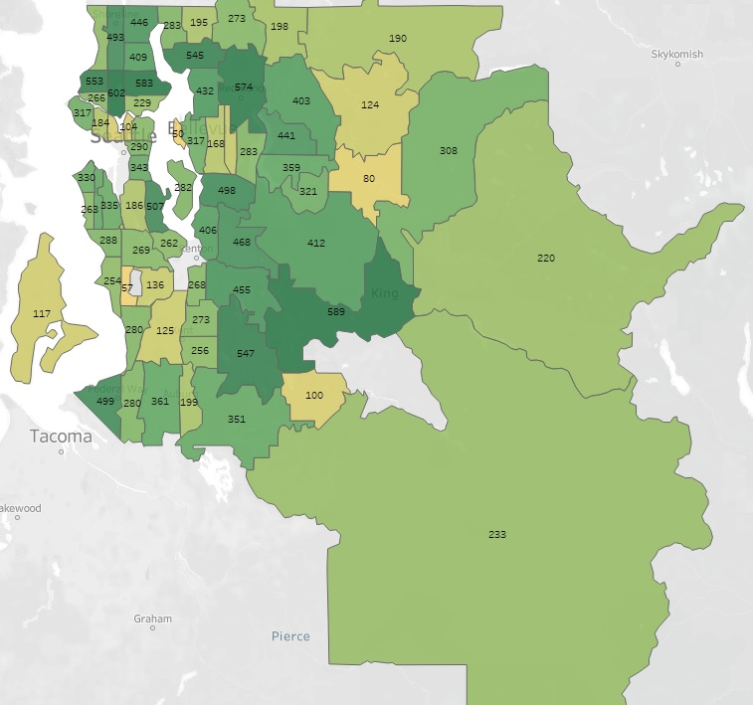
Limitations of our model
Performance of our model
Gradient Boosting Regressor best performing model (R2 score = 0.85)
Time and computational cost (in huge databases it would
be unfeasible)
We have not very large subsamples, which also limits our
ability to deal with outliers and irrelevant data (in smaller
databases would also be unfeasible).
Approaches to deal with these
limitations:
Feature selection
Grouping the zipcodes

Slide 5
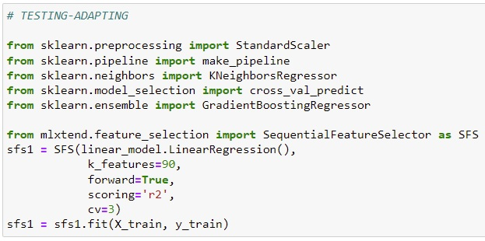
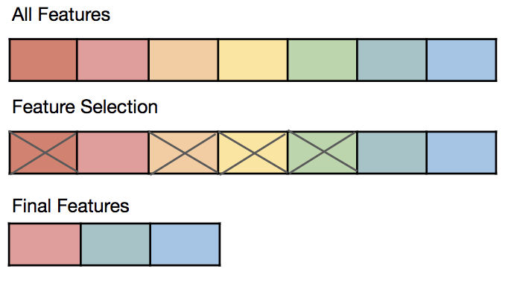
Feature selection
Starting point: 95 variables
After shrinking the number of variables, the last 50 variables just improve a 0.01 R2 score, so we could drop those variables.

Slide 6
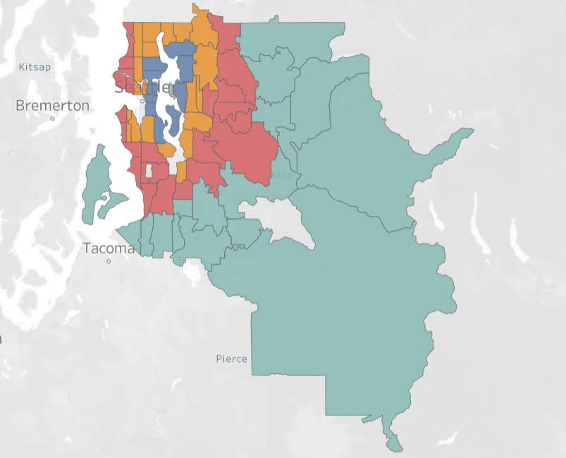
Grouping the zipcodes
We divided the zipcodes in 5 groups depending how far away were they from the most expensive area (best place to live).
Since our election of zipcodes group was arbitrary, we didn't manage to find a better performing model.

Slide 7

THANK YOU!

